Slide 1


Slide 2

OFFICERS TRAINING ACADEMY
BADGES OF RANK ARMED FORCES

Slide 3


INTRODUCTION
FOR RECOGNITION OF AUTH.
FOR DELEGATION OF TASKS.
FOR RECOGNITION OF SENIORITY.
FOR PAYING COMPLIMENTS.

Slide 4
AIM
TO AQUAINT STUDENTS ABOUT BADGES OF RANK OF THREE SERVICES.

Slide 5
PREVIEW
BRIEF HISTORY.
BADGES RANK ARMY.
BADGES RANK NAVY.
BADGES RANK AIR FORCE.
BADGES RANK NCC.
CONCLUSION.

Slide 6
BRIEF HISTORY
ANCIENT SYS – CROWNS, BODY ARMR, JEWELLERY.
BRITISH INTRODUCED UNIFORM SYSTEM.
INDIAN SYS AFTER INDIGINISATION OF ARMY.

Slide 7
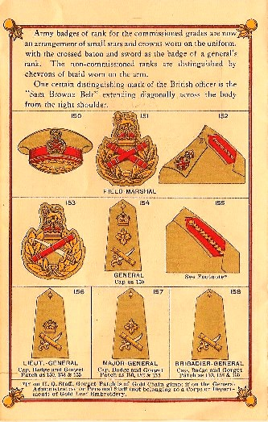
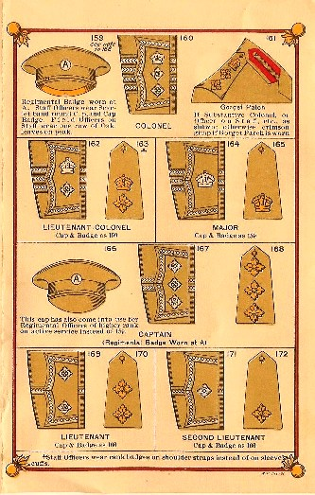

Slide 8
BADGES OF ARMY
OFFICERS.
JUNIOR COMMISSIONED OFFICERS.
OTHER RANKS.

Slide 9

RANK STRUCURE: OFFICER
ARMY | NAVY | AIR FORCE
FIELD MARSHAL ***** | ADMIRAL OF THE FLEET | MARSHAL OF AIR FORCE
GENERAL **** | ADMIRAL | AIR CHIEF MARSHAL
LT GENERAL *** | VICE ADMIRAL | AIR MARSHAL
MAJ GENERAL ** | REAR ADMIRAL | AIR VICE MARSHAL
BRIGADIER * | COMMODORE | AIR COMMODORE
COLONEL | CAPTAIN | GROUP CAPTAIN
LT COLONEL | COMMANDER | WING COMMANDER
MAJOR | LT COMMANDER | SQN LEADER
CAPTAIN | LIEUTENANT | FLIGHT LIEUTENANT
LIEUTENANT | SUB LIEUTENANT | FLYING OFFICER

Slide 10
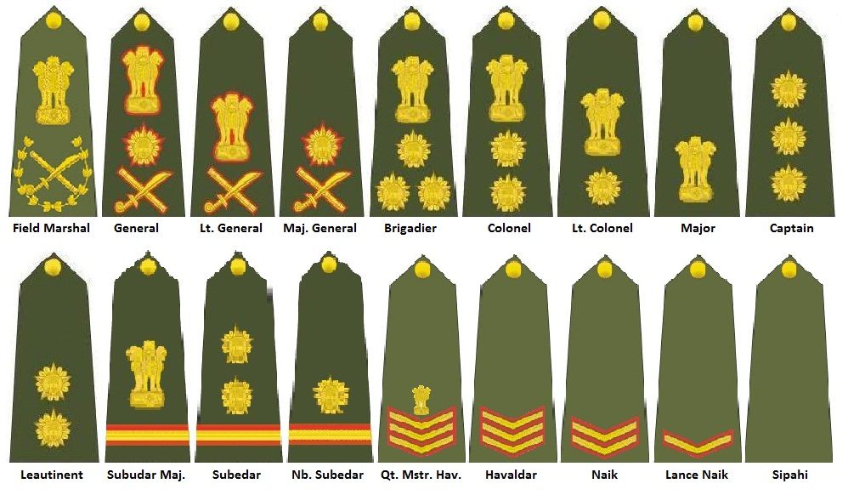
RANK STRUCURE: ARMY

Slide 11
RANK STRUCURE: ARMY

Slide 12
BADGES OF NAVY
OFFICERS.
SENIOR SAILORS (PO AND ABOVE).
JR SAILORS (LEADING AND BELOW).

Slide 13
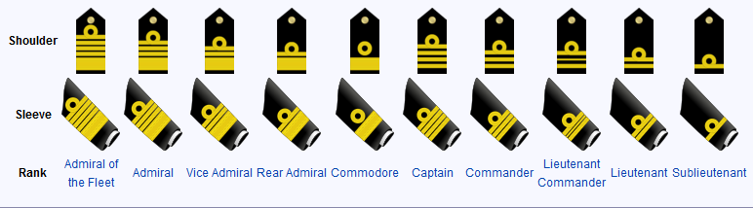
RANK STRUCURE: NAVY

Slide 14
RANK STRUCURE: NAVY

Slide 15
BADGES OF AIRFORCE
OFFCIERS.
WARRANT OFFICERS.
AIRMAN.

Slide 16
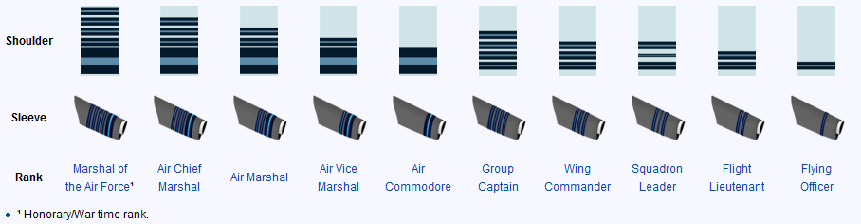
RANK STRUCURE: AF

Slide 17
RANK STRUCURE: AF

Slide 18
RANK STRUCTURE - JCOs
ARMY | NAVY | AIR FORCE
SUBEDAR MAJ | MASTER CHIEF PETTY OFFICER I | MASTER WARRANT OFFICER
SUBEDAR | MASTER CHIEF PETTY OFFICER II | WARRANT OFFICER
NAIB SUBEDAR | CHIEF PETTY OFFICER | JUNIOR WARRANT OFFICER

Slide 19
RANK STRUCURE: ARMY

Slide 20
RANK STRUCTURE - OR
ARMY | NAVY | AIR FORCE
HAVALDAR | PETTY OFFICER | SARGENT
NAYAK | LEADING | CORPORAL
LANCE NAYAK | SEAMAN I | LANCE CORPORAL
SEPOY | SEAMAN II | AIRMAN

Slide 21
RANK STRUCURE: ARMY

Slide 22
NCC RANK BADGES - ANOs
SENIOR DIVISION | JUNIOR DIVISION
MAJOR | CHIEF OFFICER
CAPTAIN | FIRST OFFICER
LIEUTENANT | SECOND OFFICER
 | THIRD OFFICER

Slide 23
CONCLUSION

Slide 24
RANK STRUCURE: ARMY

